Slide 1
Rising to the occasion: New persons for new times
Maureen O’Hara
National University & International Futures Forum

Slide 2
Crisis of civilization

Slide 3
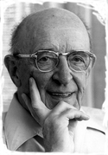
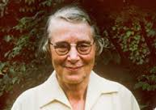
Mentors
Irene Manton PhD FRS and Carl R. Rogers PhD.

Slide 4
The challenge
Without a global revolution in the sphere of human consciousness, nothing will change for the better in the sphere of our being as humans, and the catastrophe toward which we are headed . . . will be unavoidable. Vaclav Havel (Quoted in Lasley, 1994,p. 3)

Slide 5
Psycho-cultural co-creation
Psyches create psychospheres which nurture the psyches that created them
Notes:
In stable socieites there is a reciprocal and coherent relationship between the modal psychology and the culture. These can be quite local—the bowling club, ot national –even continental

Slide 6
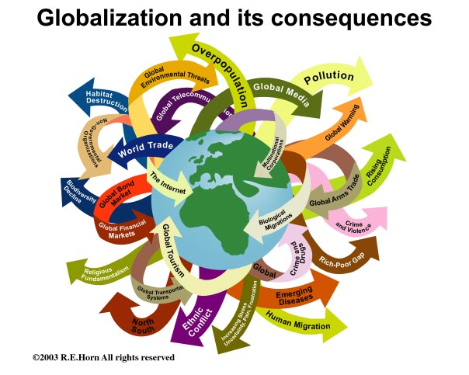
21st century sources of instability
Globalization
Technology
Complexity
Urbanization—megacities/slums
Demographics-aging West youthful Rest
Political realignments
Climate change/resource depletion
Rising expectations dignity, economic & political justice
Fundamentalism
Rise in organized crime-piracy, trafficking in sex and drugs
Inequality-- shrinking middle class between super-wealthy and destitute
Domination of all life by marketplace values.
Media bias towards Catastrophe reporting etc etc.
Wild cards?
Trump, Brexit, Terrorism, North Korea, Climate shift
Catastrophe/asteroids

Slide 7
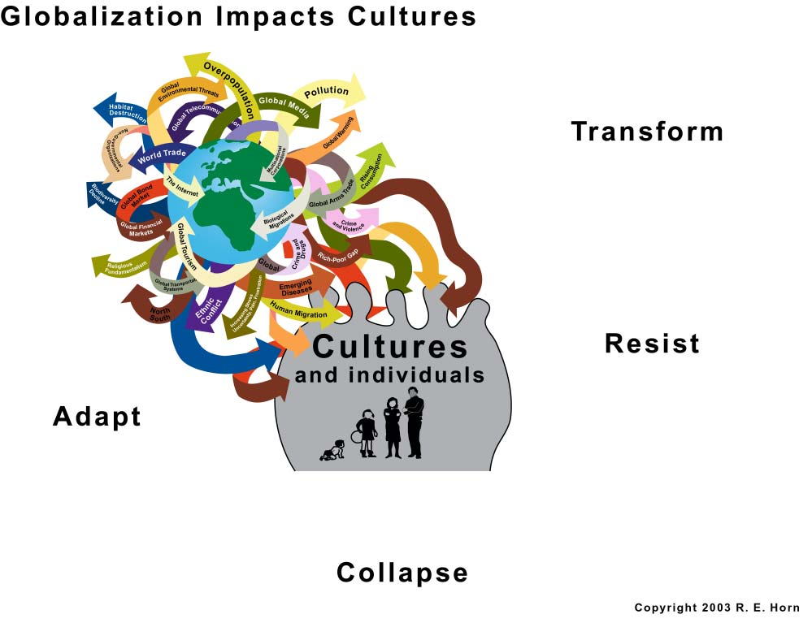
Connectivity, Globalization, Wicked Problems
Notes:
In a conceptual crisis the different responses available are not all equilvalent and not all healthy.
Adapt—may mean to develop strategies though permitting survival are ultimately mean the loss of what is valued _Iroquois didn’t want to accept this.
Resistance may mean to use resources to avoid engagement with the changes and stay locke din a bubble (Japan tried that in the eigthteenth and nineteenth centuries, Luddites proposed it in England etc
Collapse can mean failed societies—many indigenous populations are disappearing.
Transformation: Where deep social learning occurs permitting an integrative process into new ways of life that are healthy and fully human

Slide 8
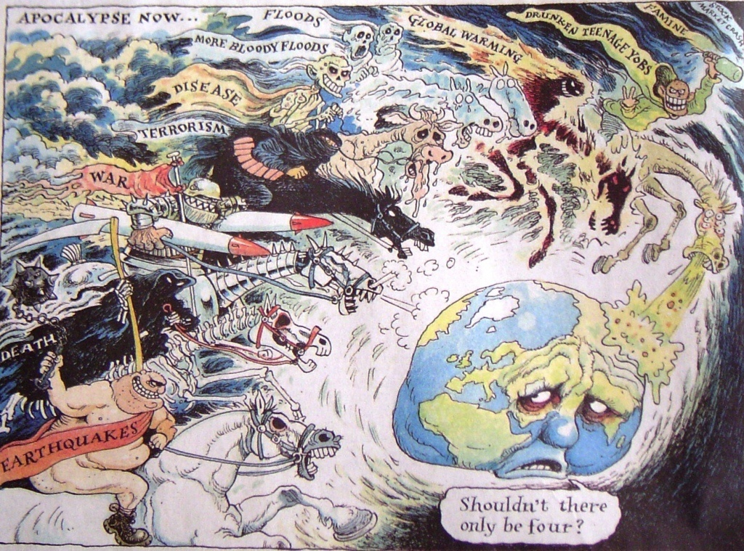
Source: The Guardian, summer 2007
Notes:
Listening to Gwynn last night I am sure we all had complex responses to what he said– what were they?
Much of this is perceived as profoundly frightening by most people.

Slide 9
Converging crises
Perfect storm
Conceptual crisis
  Conceptual frameworks and customary forms of action no longer adequate to the current conditions.
Cultural crisis
  Societies are divided and fractured and there is loss of faith in established institutions --especially governance,
Existential crisis
  Human activity now threatens life-sustaining planetary systems such as climate and atmosphere putting future of humanity as a species is at risk.

Slide 10
Interregnum
“Liquid modernity”: a state of constantly changing circumstances and shifting priorities that make it difficult for individuals to have the time or frames of reference to organize their lives under conditions of extreme ambiguity. Zygmunt Bauman
"
Notes:
. .
The world is in entering a crisis of consciousness
Consciousness adapts and evolves or collapses
New practices that can cultivate new minds are available and more can be developed.
Presently innovation is in informal spheres-on the street, spiritual practice, psychotherapy, workplace training and change management activities, the arts, Burning Man but so far it a guiding mythos
Conscious evolution is a community responsibility
Can we bring these into our institutions to make them available as part of experiences?

Slide 11
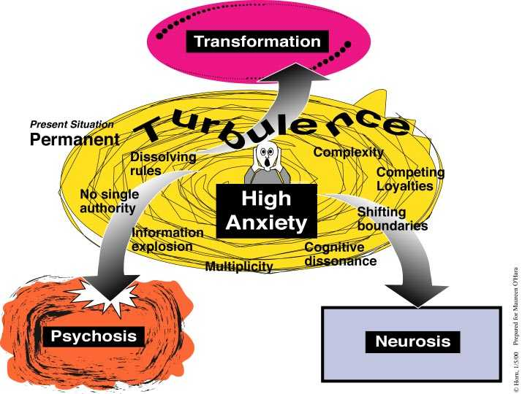
COLLAPSE
CONTROL
Notes:
Some psychological givens
Minds are open systems
Minds develop with experience
Change creates psychological crisis
Predictable responses are DEFENSIVE, DESTRUCTIVE and/or TRANSFORMATIVE
Internal mental capacities & external resources determine which it will be.

Slide 12
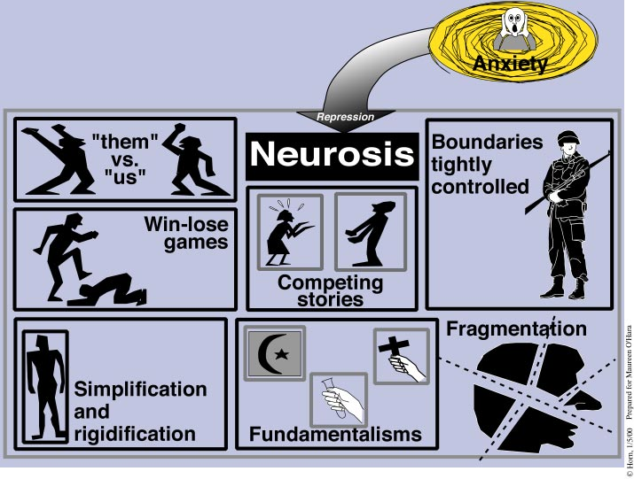
CONTROL
Winners and Losers
Denial
Stay in the box
Simplify/rigidify
Add more rules

Slide 13
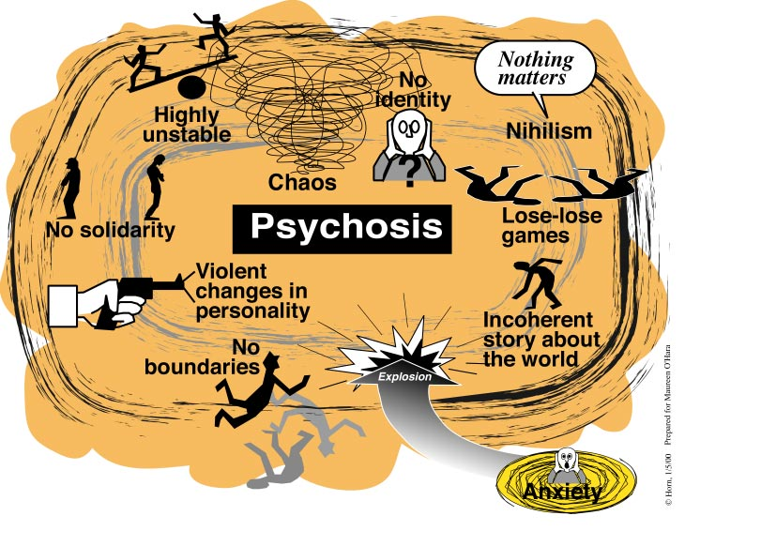
COLLAPSE
Collapse
Changes
Anarchy
Notes:
One major consequence of the accelerated pace of life in our
time is the breakdown of long standing boundaries---those
boundaries that differentiate the public from the private, the
domestic from the foreign, the local from the global, the political
from the economic, to mention only a few of the distinctions that
had become commonplace and that are today so obscure as to be
the source of the widespread insecurities, uncertainties,
ambiguities, and complexities that prevail throughout the world.
The 9/11 attacks did not initiate the insecurities, uncertainties,
ambiguities, and complexities; rather, the attacks aggravated
dynamics that were already deeply rooted in the social, political,
and economic life of people, communities, and societies.
The repercussions of the Middle Eastern and India-Pakistan
crises as well as the war on terrorism strike me as being on an
order of magnitude far beyond any that have been experienced
since the end of the Cold War. Indeed, the Cold War was at least
marked by a form of stability, but today instability, even chaos,
seems to mark the prevailing order.

Slide 14
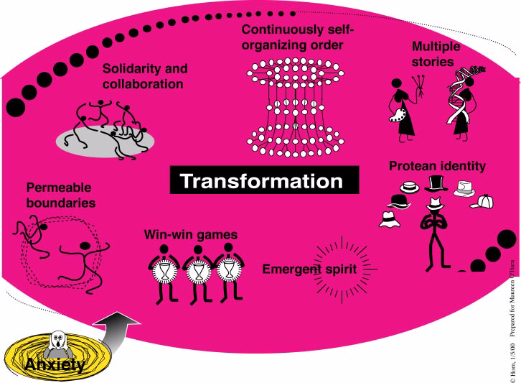

Emergent consciousness
Social Justice -economic-justice
eco-sustainable
Notes:
Some people when faced with overwhelming dissonnance seem to be able to resolve the dilemmas by reorganizing their consciousness, knowledge etc. to a higher order.
I propose that one of the survival task of our generation is to learn how to make this scenario more likely.

Slide 15
Modern Western Psychology
Distrusts body--splits "mind" from "body“
Distrusts intuition and emotion
Distrusts empathy
Competes with everyone
Collaborates only strategically
Rational
Mechanistic
Objective
Clear fixed boundaries
Reductionist
Sees parts)
Individualistic
Analytic
Abstract, deductive & theoretical reasoning

Slide 16
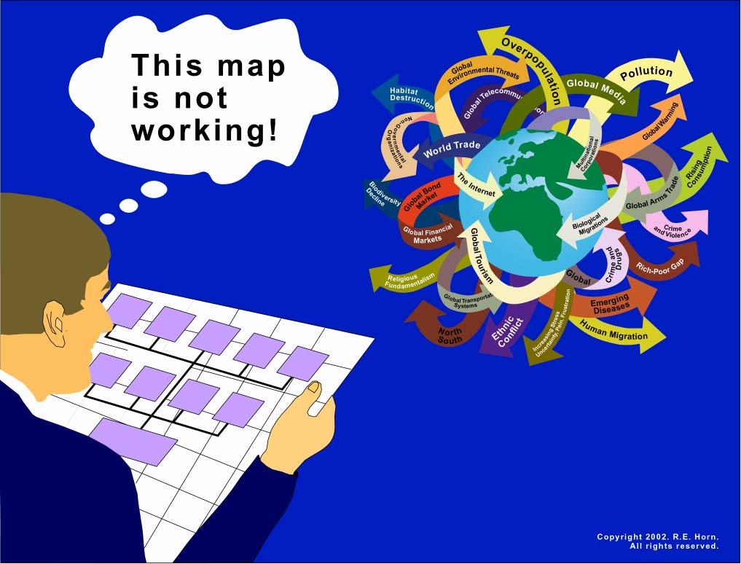
Modern mind-Postmodern world
Notes:
We have come to a point in history where (like the Onandaga Indians who realised that the Colonial education was producing people who did not fit in their home communities) we are producing people who do not fit in our changed world.

Slide 17
Persons of tomorrow: Carl Rogers
At home in turbulent times.
Process persons, Trust
Combine reason and intuition
Open to learning from new experiences
Desire authenticity/intimacy
Seek relationship with Nature
Internal moral compass
Resilient
Trust the creative force
Courage to face the future without illusion
Empathic
Self reflective
Relationally competent
Inclusive of “others”
“THEY WILL BE ABLE TO MAKE THE PARADIGM SHIFT”

Slide 18
Wizards of IFF

Slide 19
IFF Praxis: Adding to social capacity
Expertise in the background
Facilitated dialogue
Shadowing models
Learning journeys
Deep listening/empathic/associative/engaged
Listening for process beyond content
Listening through subjective ears, looking through subjective eyes loving.
Listening for the creative impulse

Slide 20
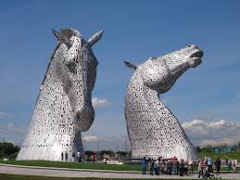
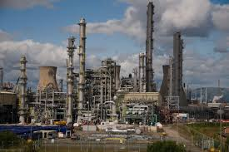
FALKIRK’S NEW IDENTITY

Slide 21
My Future’s in Falkirk project

Slide 22
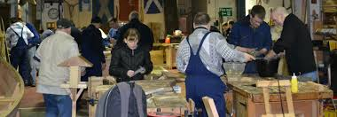
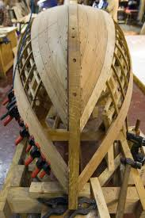

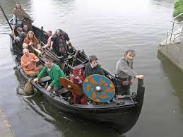
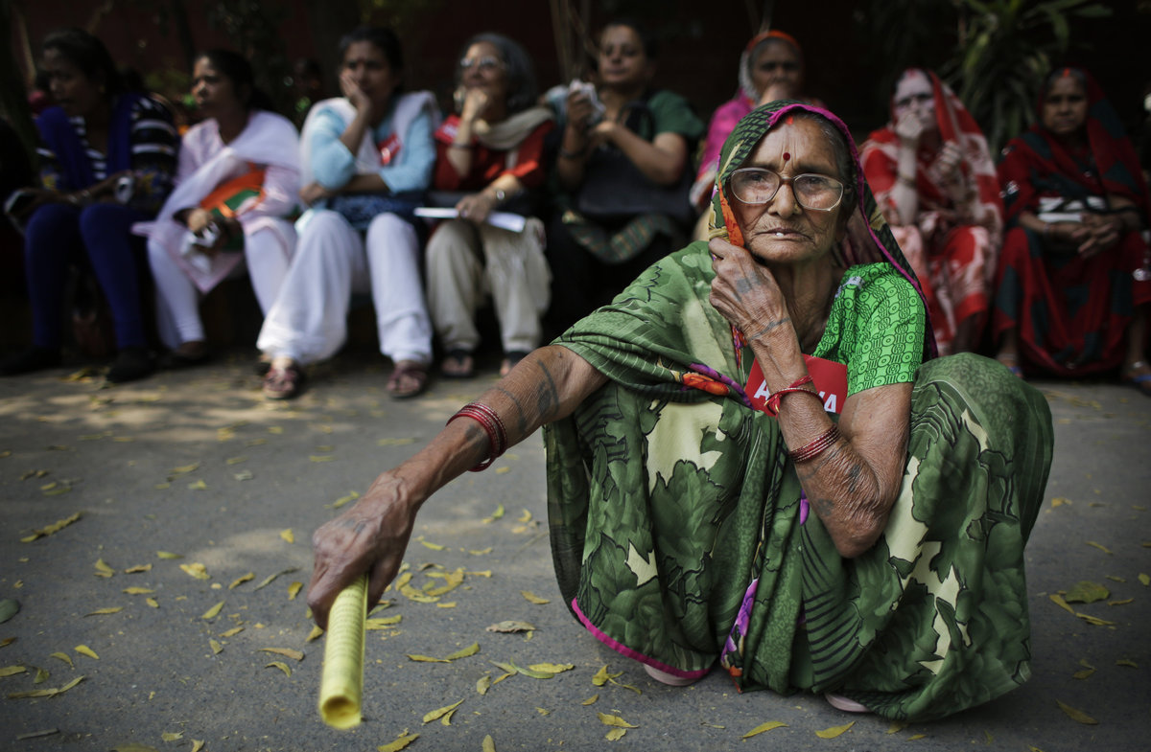
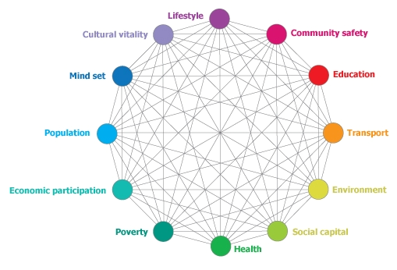

SHINE, Galgael: Applying old wisdom to new problems, Producers, Nuka Model of Care
Conversations

Slide 23
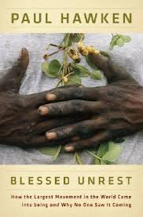
Awareness, Participation, Empathy, Empowerment, Authenticity, Transparency, Listening Communication, Appreciation, Dialogue, Flexibility, Tradition, Ritual, Mutual Respect, Humility, Collective Deliberation, Diversity, Trust, Self-governance, Wisdom of the group, Transformative Conversation, Collective Intelligence, Respectful relationships and Non-violence, Justice

Slide 24
Another world is not only possible, she is on her way. On a quiet day, I can hear her breathing
Arundhati Roy, Porto Alegre, Brazil 2003

Slide 25
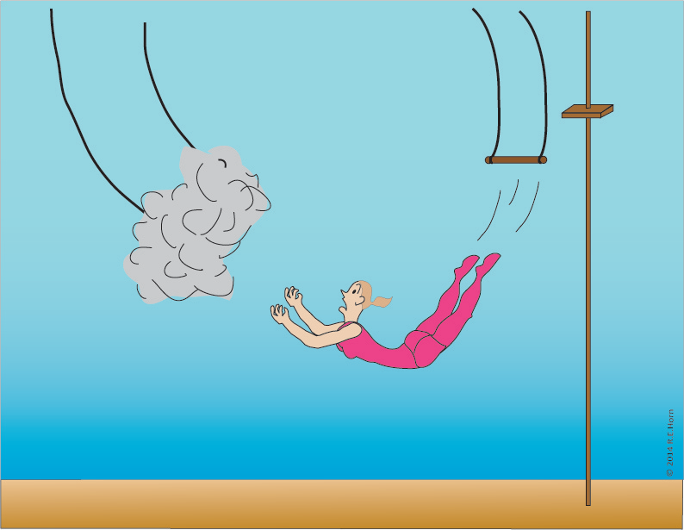

Slide 26
Contact mohara@nu.edu www.maureen.ohara.net
Maureen O’Hara, PhD.
International Futures Forum-US
Department of Psychology
National University,
La Jolla, USA

